Slide 1
Finance
Guiding Questions
How will the project be financed sustainable way?
What are your sources of financing?
Do you have innovative strategies to finance your project?
How will you ensure that the project is solvent in the long term?

Slide 2
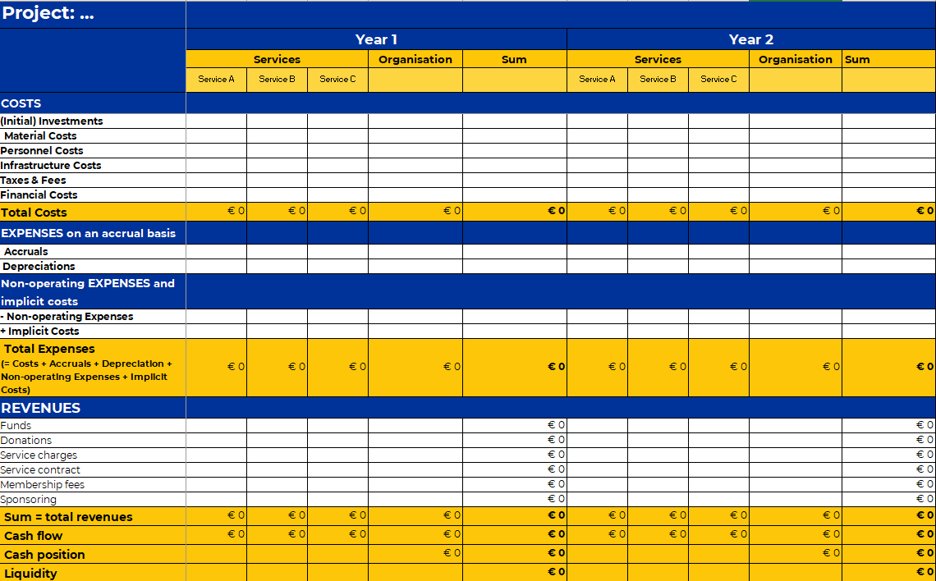
Finance
Check out the Excel “Financial Plan” to calculate your cash flow and liquidity!

Slide 3
My Project: Finance
 | year 1 | year 2 | year 3 | year 4 | year 5
COSTS
(Initial) Investments
Material Costs
Personnel Costs
Infrastructure Costs
Taxes & Fees
Financial Costs
Total Costs
REVENUES
Funds
Donations
Service charges
Service contract
Membership fees
Sponsoring
Cash flow
Cash position
Liquidity

